Slide 1
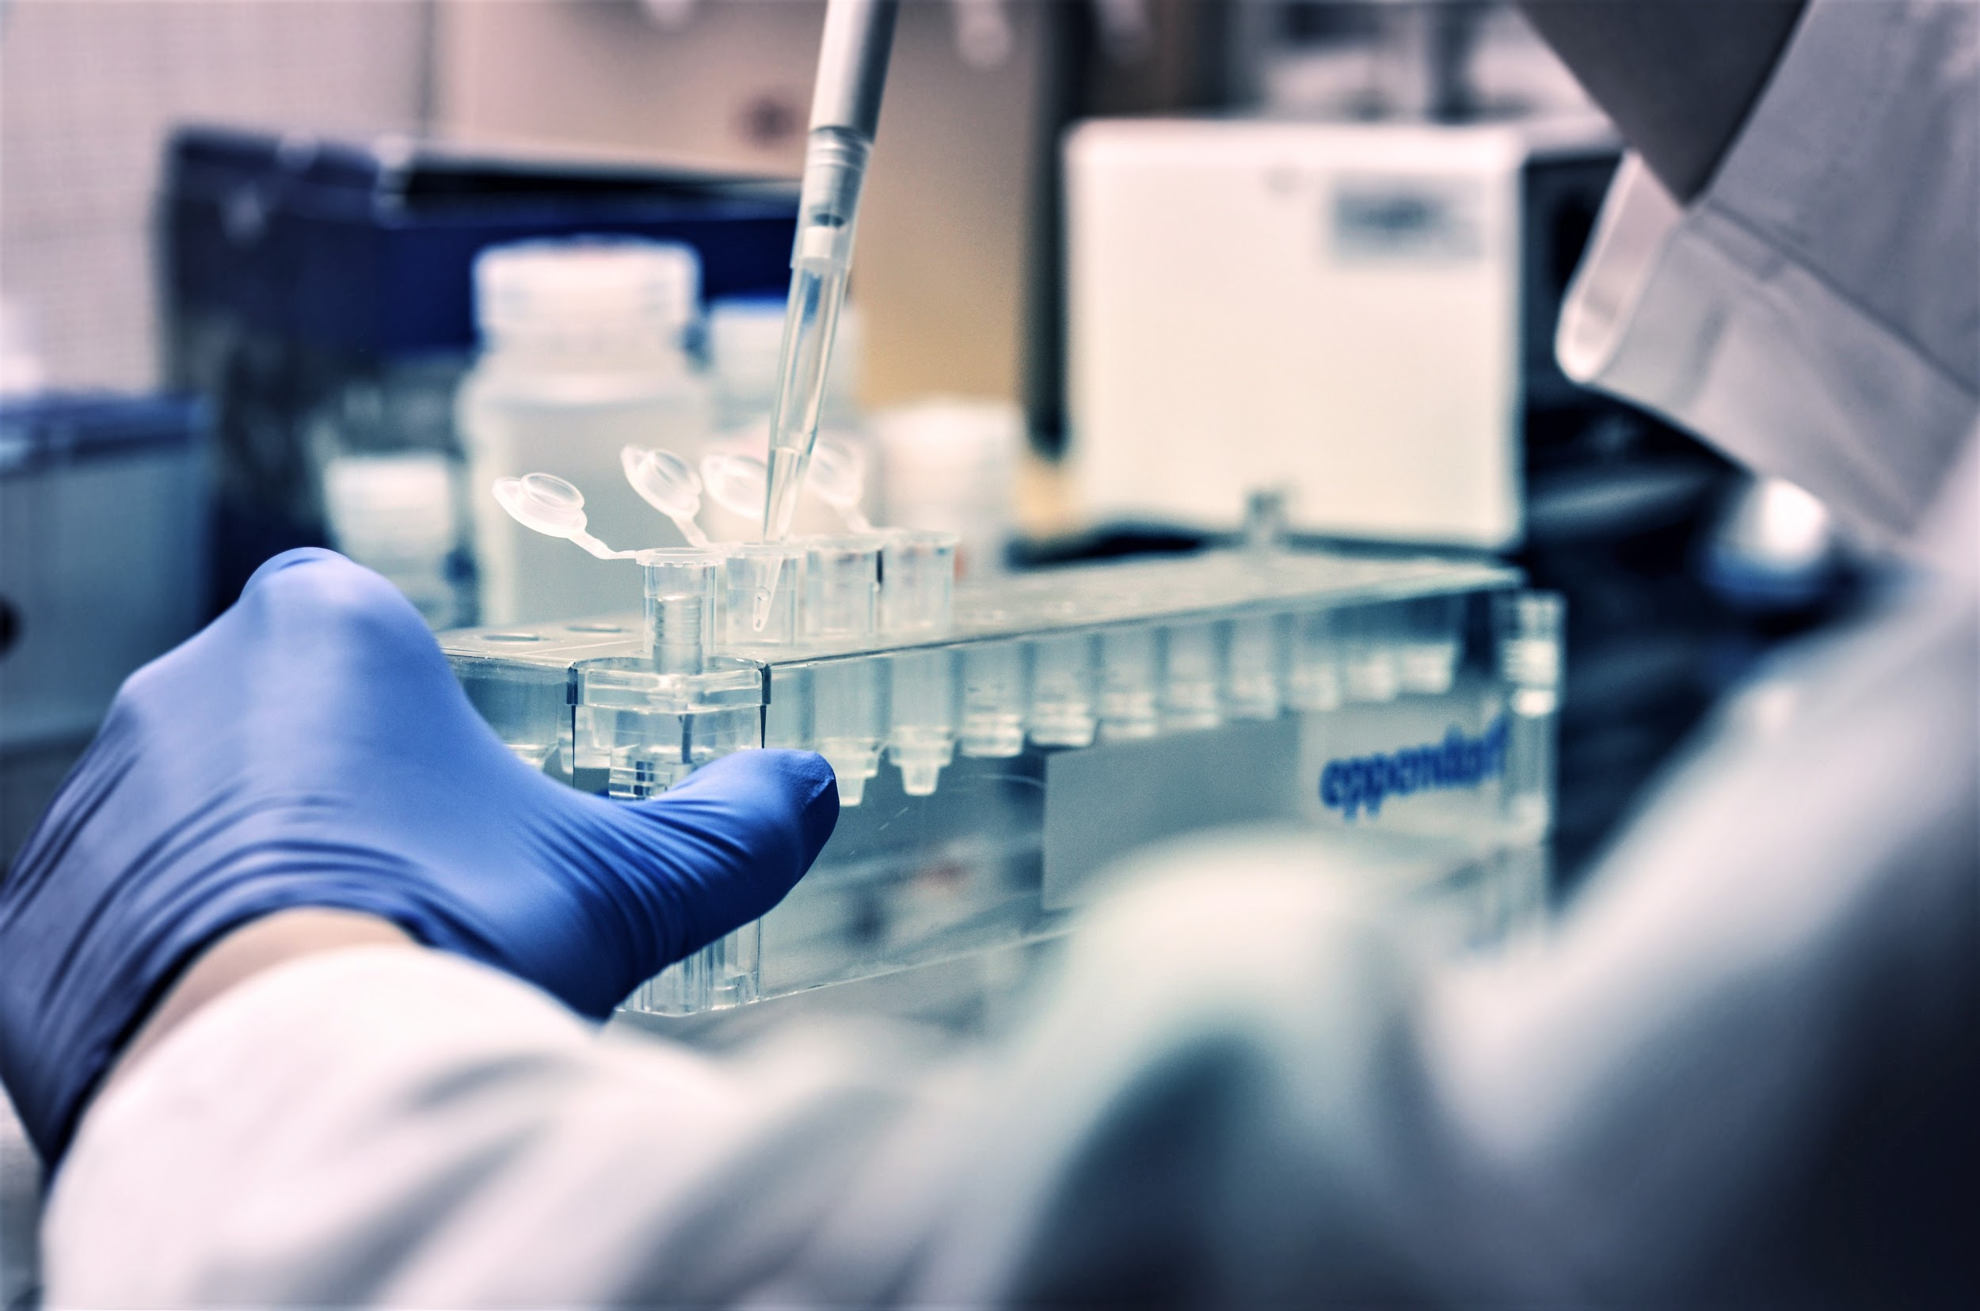
Testing Efficacy of Class-Based Undergraduate Research Experiences
Nolan Takeya
Mentor: Alaron Lewis
Notes:
For my research project I am presenting testing efficacy of class-based undergraduate research experience (also known as the CURE). My mentor in this project is Alaron Lewis

